Slide 1
Capstone Project - The Battle of Neighborhoods Capstone Project - The Battle of Neighborhoods
Helping Newbie in Toronto
Designed and Created by
Naved Akhtar
04-02-2020

Slide 2
Business Problem:
When everything is available on internet and its very easy to search then why we need to code. The issue is a new person will not know the areas near Toronto. As Toronto is too big to analyze each and every area for crime, rent and business. That’s why I come up with a program which will help a new person to give his preference like Max rent, Max crime rate and also which business he wants to open. By this its will be very easy for him to choose among different areas.

Slide 3
Data Acquisition
CrimeData:
https://github.com/naveakht/Coursera_Capstone/blob/master/Homicide.csv
RentData: https://raw.githubusercontent.com/naveakht/Coursera_Capstone/master/Toronto_apartment_rentals_2018.csv
Business Search:
Using the above Crime and Rental data, I have comeup with the best possible combination by considering MAX_RENT and MAX_CRIME. By using this I got the below dataframe and then I used Foursquare API to find near by business which deal in Dog.

Slide 4
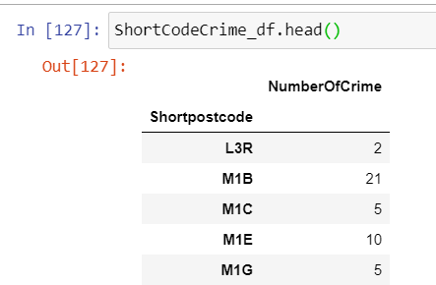
Data Cleaning
CrimeData: This data is cleaned keeping in mind that we need to get the result on the basis of 3 word postcode ex: M5J. There are lot of error for which I used excel sheet to correct it.

Slide 5
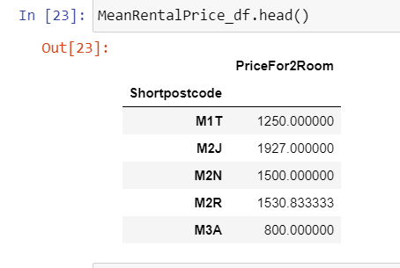
Data processing over Rent data
Used geolocator.reverse to get the postcode using Latitude and longitude. Use substring to save only first 3 characters of postcode for easy processing.
I have recalculated the price for 2 BedRoom and 1 Bathroom using other sizes.

Slide 6
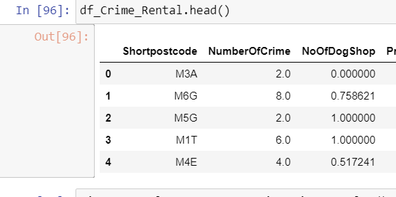
Data Processing Over Business Search:
Using the above Crime and Rental data, I have comeup with the best possible combination by considering MAX_RENT and MAX_CRIME. By using this I got the below dataframe and then I used Foursquare API to find near by business which deal in Dog.

Slide 7
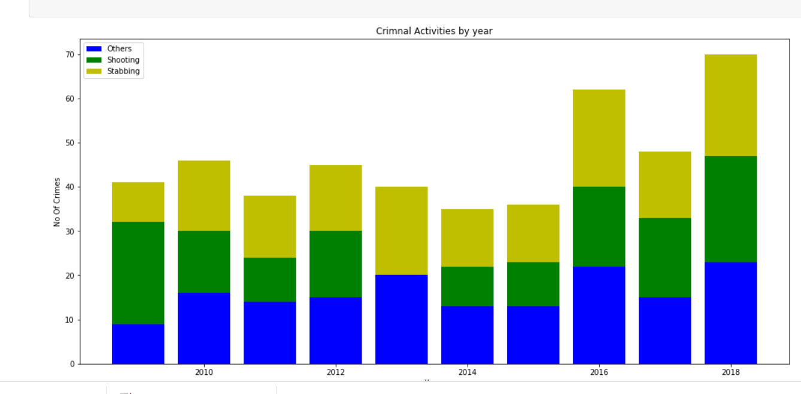
Findings
1- By using crime data over last 10 years it has been found that crime is bit Increased in all the Type (Shooting, Stabbing and Others).

Slide 8
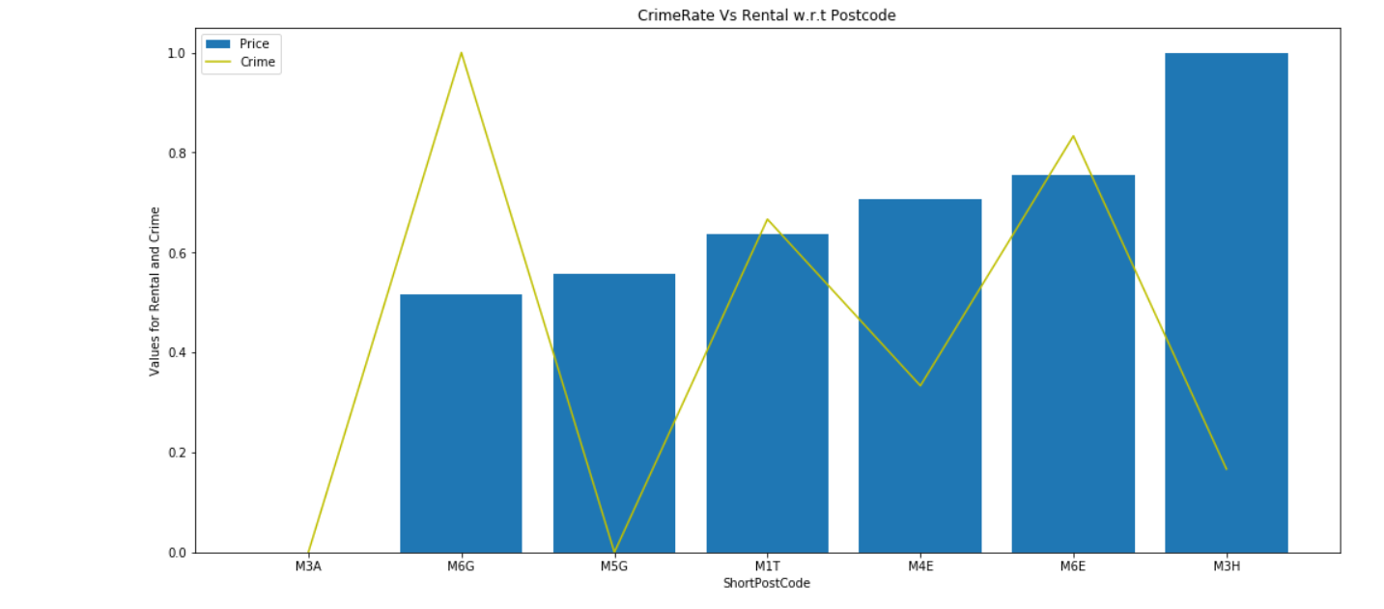
2- Crime and Rent on a same chart will be a good so that we can see the relation between rent and crime. To do this I normalized both Crime and Rent data and come up below graph.

Slide 9
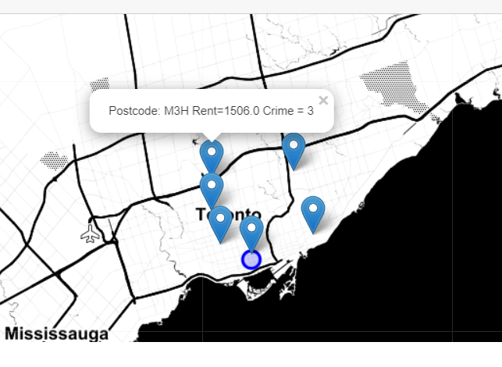
Lets maps this postcode over map to see its distance from Toronto Main city.

Slide 10
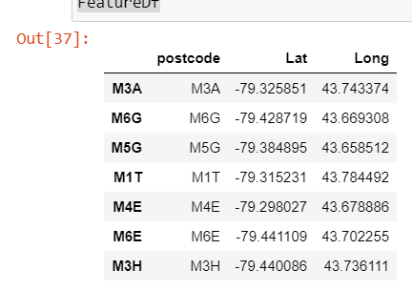
To find this I have used Foursquare API. To get the Latitude and longitude of these 2 postcodes I have again used my dataset and get the cordicates on the basis of postcode. It comes like below dataframe.

Slide 11
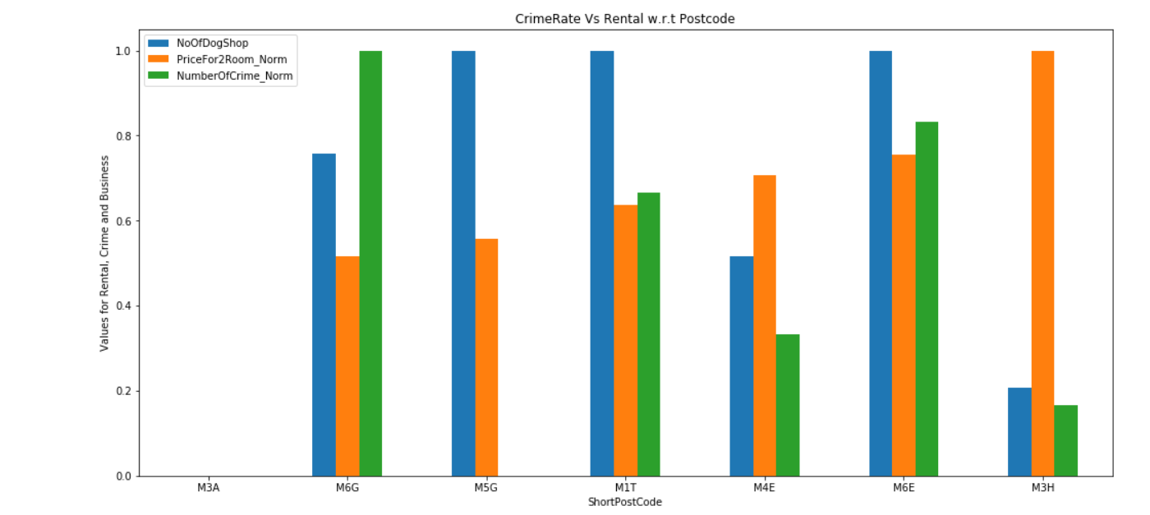
Once I got all the data in place, I put them into graph to see the best combination.

Slide 12
Result and Discussion:
By looking the above graph it can be easily seen that M3H postcode is best according to selected criteria. It has rent just below 1500$ which is less than maximum limit of 1700$ also crime rate is much below to 3 which is also less than 10 (Max crime limit). Apart from this the Dog business is very less compared to other localities. Also looking at map it can be easily checked that this area is bit far from Toronto main city.
2nd Postcode will be M4E, which has bit more crime rate but less rent and bit more competition in business. But this area is close to Toronto main city.

Slide 13
Conclusion:
I would like to conclude the report by saying that this is report will provide genuine filter criteria on the basis of different factors. As this report is used keeping in mind that crime data and rent data of many localities are not present which is quite hard to manipulate the exact result.

Slide 14
THANK YOU

